Slide 1

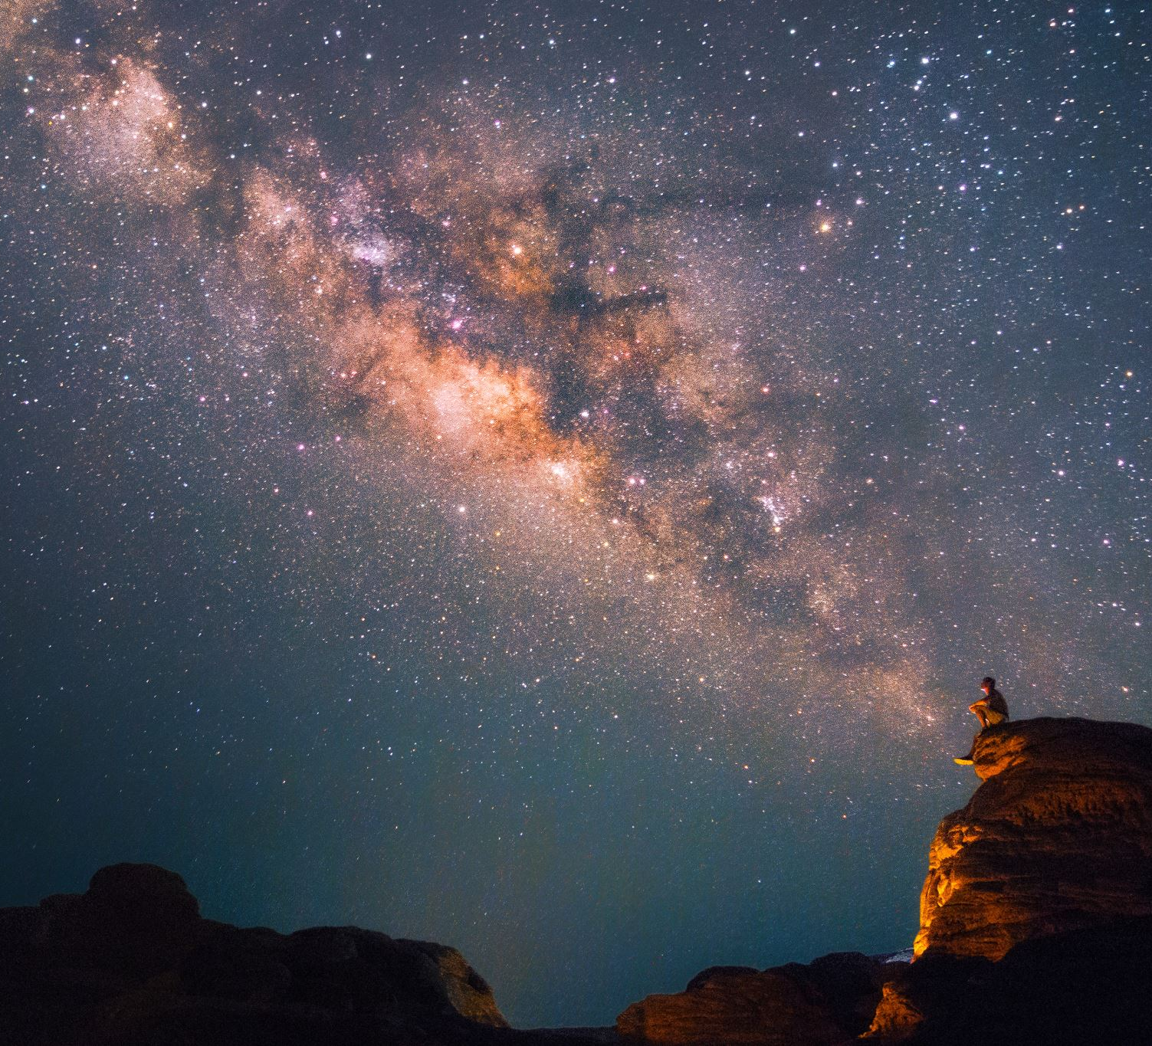
Stellar-Map
Benjamin Huber & Julia Müller
Notes:
If you look up into the sky during a clear night, you will find it covered with stars.
But what kind of stars are there? How far away are they exactly and which ones are the closest? Is the brightest star in the sky really the most luminous one?

Slide 2
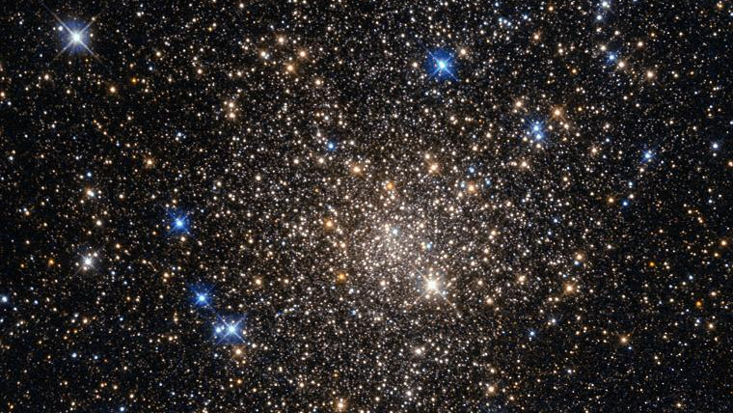
Notes:
Our goal is to answer such questions based on visualizing real astronomical data into a 3D stellar map in a web application.
Stars are classified by their lights’ spectra (the elements that they absorb) and their temperature.
Within our map, we want to show, how the spectral types, magnitude, brightness, etc. of stars is related to their stellar position in our galaxy.

Slide 3
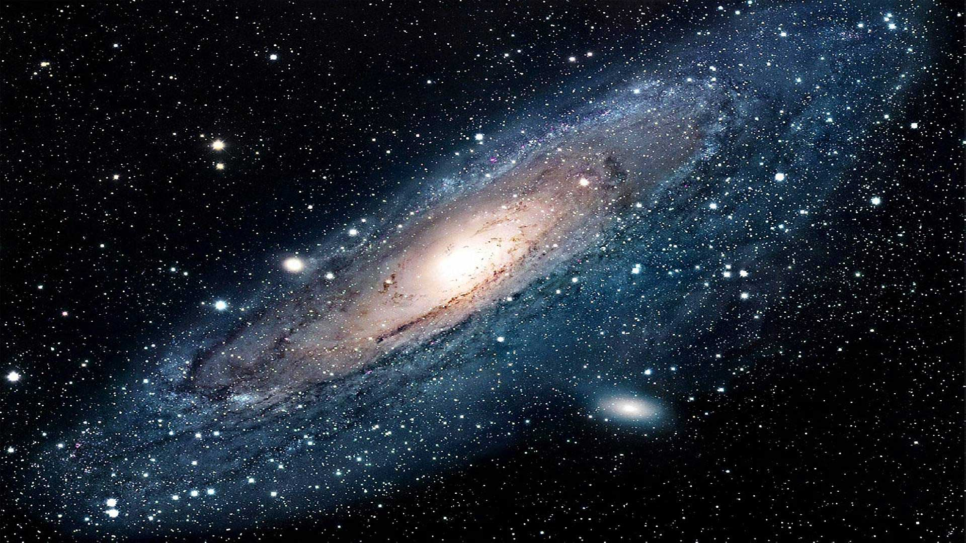
Notes:
Why did we choose this topic? We are both very interested in astronomy.
These giant lightballs up in the sky can be very fascinating as they are different in size, color, constellations and many other properties.
There are many visualizations of 2D Maps already, so we wanted to make something different and decided to do a 3D map.

Slide 4

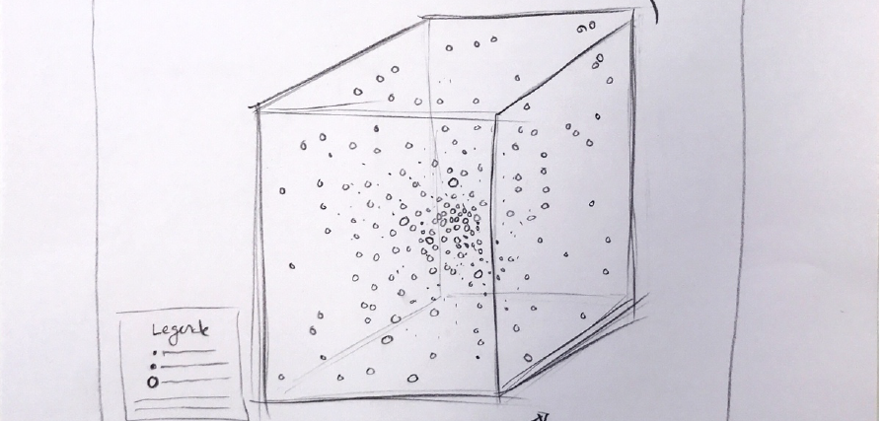
Notes:
We want to place the user as an observer into our map.
He shall be able to navigate through our near universe and be able to inspect stars of interest.
To achieve that, our goal is to create an interactive 3D Map, where each dot is representing a star.

Slide 5

Notes:
The dataset we used is a subset of the data in three major star catalogs: the Hipparcos Catalog, the Yale Bright Star Catalog and the Gliese Catalog of Nearby Stars.
All 3 catalogs are collections of stars observed by satellites of NASA.
Being able to work with real astronomical data made the work on this project very exciting.

Slide 6

Notes:
So as we started investigating the data, we needed to find out which properties useful to create the map as we saw it in our vision.
The first and probably the most important one are the X, Y and Z Coordinates to place a star.
the center (0, 0, 0) is the earth and the units are units of parsecs, which is 3.26 Lightyears.

Slide 7
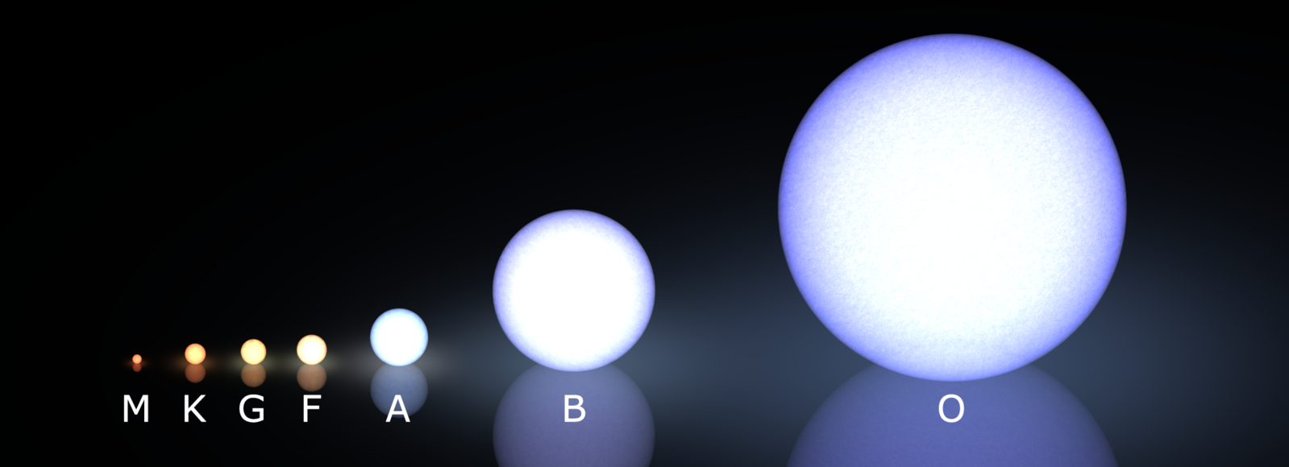
Notes:
Another very important attribute to display color is the spectral type of a star.
There are seven main types of stars. In order of decreasing temperature, O, B, A, F, G, K, and M.
O and B stars are uncommon but very bright; M stars are common but dim..
An easy mnemonic for remembering these is: "Oh be a fine guy/girl, kiss me."

Slide 8
Notes:
There is no attribute like size, mass or radius that directly describes the size of a star.
To still be able to do that, we chose the optical magnitude.
The optical magnitude describes, how big and how bright a star appears in the sky from a certain distance. In our data, the distance used is 20 parsec, so around 65 Lightyears.

Slide 9



Notes:
As we now identified our key features, we had to cleanse the data of missing values and other disturbances.
We achieved that in the programming language python as we were both familiar and visited several data science courses featuring python.
In the end, we could only use 10’000 of 115’000 stars, which is around 9%.

Slide 10


Notes:
Which technology?
In our project we choose the framework three.js. It is used to create and display animated 3D graphics in a web browser. Three.js also uses WebGL, which is a JavaScript API for rendering interactive 2D and 3D graphics. (So perfect for our project.)

Slide 11

Notes:
UI Design:
For our UI we have created a color-board to use the perfect colors in our visualization. We choose dark and greenish colors for giving the stellar-map a futuristic look. The dark colors should also stand in contrast with the bright colors of the different spectral-types of all the stars in the map.

Slide 12

Notes:
Show Demo:
Here we can see a button we created in our visualization. We have applied our colors form the board to this button on our start-screen. After pressing this button it shows the actual stellar-map.
Now we will show you a demo of our project.

Slide 13
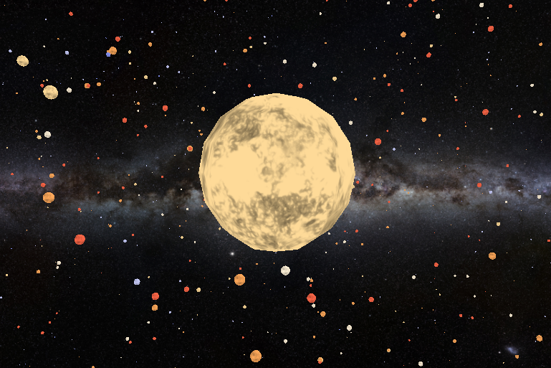

Notes:
Further Improvements:
For further improvements we want to create a halo border when selecting a star. So it it gives the user more feedback for interacting with the visualization.
Another improvement would be to format the text better in the legend for “Selected Star”, like to round the text to two decimal places.

Slide 14
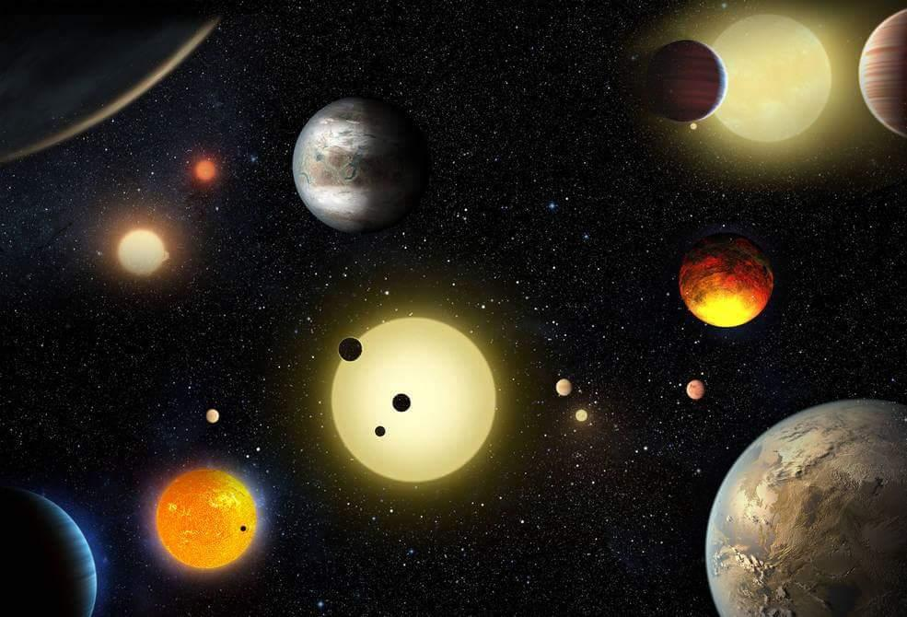

Notes:
Conclusion – End:
As a conclusion we can say that it was fun to explore something you are really interested in and combine it within a project. In our case it was 3D-Design and astronomy.
We can also say that 3D visualization need a lot of performance. So you need to adopt efficient practices when creating those.

